Slide 1
‘Enabling Prison Education: Overcoming Barriers Faced by Incarcerated Students.’ 5th Enabling Symposium - National Enabling Educators Association of Australia – University of Southern Queensland Ipswich Campus
Dr Susan Hopkins
Open Access College
University of Southern Queensland
Susan.Hopkins@usq.edu.au

Slide 2
Presentation based on:
Hopkins, S. and Farley, H. (2014) ‘A Prisoners' Island: Teaching Australian Incarcerated Students in the Digital Age’, Journal of Prison Education and Re-entry (JPER) 1, 1, 42-51.
Hopkins, S. ‘Reducing Prisoner Reoffending through Education’ The Conversation, June 16, 2015
http://theconversation.com/by-freeing-prisoners-from-cycle-of-crime-education-cuts-re-offending-42610
+ ongoing research collaborations in enabling education and transformative digital prison pedagogy between USQ OAC and USQ ADFI academics within the ADFI Making the Connection Research Stream led by ADFI Associate Professor Helen Farley

Slide 3
Data from OAC Triple E project:
TPP
(OAC)
USQ Open Access College Tertiary Preparation Program (TPP) – an enabling ‘bridging’ program to prepare students for undergraduate study with guaranteed entry to some USQ undergraduate courses
ADFI
Projects
2012 USQ ADFI PLEIADES project (Portable Learning Environments for Incarcerated Adult Distance Education Students) trialled eReaders and internet simulation at SQCC
OAC Triple E (2013)
2013 OAC Triple E (Engagement, eLearning and eReaders) project – 47 eBook readers rolled out to five QLD correctional centres – SQCC, Brisbane Women’s Correctional Centre, Wolston Correctional Centre, Woodford Correctional Centre and Maryborough Correctional Centre.
eReaders loaded with TPP7120 course readings and course content
USQ ADFI From Access to Success project and Stand Alone Moodle (SAM) at SQCC
TPP7120 Studying to Succeed, TPP course (which teaches essential skills in academic communication and study management) loaded on to eReaders for incarcerated students in 2013
An enabling program or bridging pathway which enables incarcerated students (most of whom have not completed secondary schooling) to transition to tertiary study even while incarcerated
Informed by larger USQ ADFI projects serving and researching digital prison pedagogy:
USQ ADFI Making the connection: Improving Access to Higher Education for Low Socio-Economic Status Students with ICT Limitations develops a complete higher education pathway aimed at widening access for Indigenous and non-Indigenous incarcerated students.
TPP Teaching visits to correctional centres

Slide 4
Incarcerated Students:
The University of Southern Queensland (USQ) is one of the largest providers of higher education to Australian prisoners
Over 200 inmates each year across 56 correctional centres throughout Australia enrolled in the USQ TPP
Over 100 incarcerated distance education students enrolled in USQ degree level study (principally in Business, Engineering, Arts and Human Services)
Australia has a history of penal isolationism, incarceration on the rise – the penal state
Australian prisoners are typically poor, uneducated and unemployed at the time of incarceration (Australian Bureau of Statistics, 2014; White & Perrone, 1997; White & Graham, 2010; Vinson, 2004; Vinson, 2007; see also Reiman & Leighton 2010) and are likely to stay that way without adequate support for further education.

Slide 5
Who are the Incarcerated?
The Australian prison population has recently hit a ten year high, with 33, 791 in adult corrective services custody, and with incarceration rates rising, especially for women and Aboriginal and Torres Strait Islander peoples (Australian Bureau of Statistics 2014).
The national imprisonment rate is now 185.6 prisoners per 100 000 adult population – which is almost three times higher than in Scandinavian countries (Australian Bureau of Statistics 2014; International Centre for Prison Studies 2015).
Incarceration rates are even higher in Queensland at 192.9 prisoners per 100 000 adult people - the highest imprisonment rate since 2004).
Over 90 percent of Australian prisoners are male, while Aboriginal and Torres Strait Islander people comprise over one quarter (9264 or 27%) of the total prisoner population (Australian Bureau of Statistics 2014).
The female imprisonment rate has however more than doubled in recent years (Australian Institute of Family Studies, 2015).
Australian governments are planning more prisons despite the fact it costs around $AU 174 a day to keep a prisoner behind bars (Audit Office of New South Wales 2006) and there is actually little evidence that criminalizing more behaviours and increasing sentences actually deters crime (Ritchie 2011).

Slide 6
Barriers to participation for prisoners
No internet access
Digitisation of tertiary education
Unreliable access to staff, text books, library materials, computers and other resources
Transfers, lockdowns and restrictions on spaces and movement between spaces
Shifting economic and political climate – from the Welfare State to the Penal State
Postsecondary education devalued
Implicit (and explicit) discrimination
Personal, social and cultural barriers and obstacles to successful completion of programs
Others?

Slide 7
Overcoming Barriers
Digital alternatives
Transformative prison pedagogy
Teaching visits
Recovering the value of education and postsecondary education for prisoners in neo-liberal times
Specialised support
Specialised courses
Resistance to neo-liberal pressures and priorities
Policy change
Others?

Slide 8
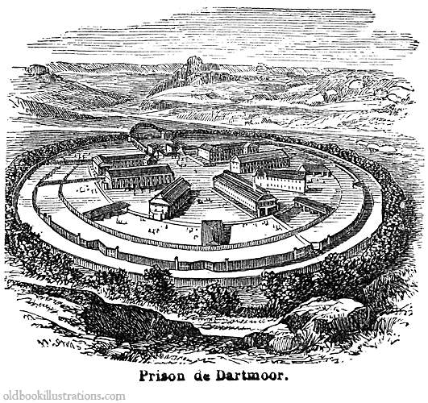
Questions? Comments?

Slide 9
References
Audit Office of New South Wales / New South Wales Auditor General. (2006). Prisoner Rehabilitation: Department of Corrective Services, Audit Office, New South wales, Australia. Retrieved from, http://www.audit.nsw.gov.au/ArticleDocuments/138/151_Prisoner_Rehabilitation.pdf.aspx?Embed=Y
Australian Bureau of Statistics. (2014). Prisoners in Australia. Retrieved from http://www.abs.gov.au/AUSSTATS/abs@.nsf/PrimaryMainFeatures/4517.0?OpenDocument
Australian Institute of Family Studies. (2015). Addressing Women’s Victimisation Histories in Custodial Settings. Retrieved from https://www3.aifs.gov.au/acssa/pubs/issue/i13/i13b.html
Australian Institute of Health and Welfare. 2012. Mental Health of prison entrants. Retrieved from http://www.aihw.gov.au/WorkArea/DownloadAsset.aspx?id=10737422198&libID=10737422198
Reiman, J. & Leighton, P. (2010). The Rich Get Richer and the Poor Get Prison: Ideology, Class and Criminal Justice, Allyn & Bacon, Boston, the United States.
Ritchie, D. (2011). Does Imprisonment Deter? A Review of the Evidence, Sentencing Advisory Council, Melbourne, Victoria. Retrieved from https://www.sentencingcouncil.vic.gov.au/sites/default/files/publication-documents/Does%20Imprisonment%20Deter%20A%20Review%20of%20the%20Evidence.pdf
Smith, M. (2014). Can Prisoners Receive Quality Education without Access to the Internet? Right Now: Human Rights in Australia. Retrieved from http://rightnow.org.au/topics/education/can-prisoners-receive-quality-education-without-access-to-the-internet/
Vinson, T. (2004). Community Adversity and Resilience: The Distribution of Social Disadvantage in Victoria and News South Wales and the Mediating role of Social Cohesion, Jesuit Social Services, Richmond, Victoria.
Vinson, T. (2007). Dropping off the Edge: The Distribution of Disadvantage in Australia, Catholic Social Services Australia and Jesuit Social Services, Richmond, Victoria.
White, R. & Perrone, S. (1997). Crime and Social Control, Oxford University Press, Victoria.
White, R. & Graham, H. (2010). Working with Offenders: A guide to concepts and practices, Willan Publishing, New York.

